Slide 1

Sentiment Analysis Using VADER and ROBERTA Models
Analyzing Customer Reviews
Made BY:-
BT21CSE069 PANDEY SWETH SATISH
BT21MME002 SHAIKH SATTAR JAAN MAHMAD
BT20CIV093 SHAIKH FAIZAN SHAIKH MOHAMMED IQBAL
BT20CME086 SAYYED KAIZAD SAYYED SAJJAD
BT21EEE063 SHAIKH ARSHAN MUSADDIQ

Slide 2

Introduction
Sentiment analysis, also known as opinion mining, is a powerful natural language processing (NLP) technique used to extract and analyze emotions, opinions, and sentiments expressed within text data. It plays a crucial role in understanding how people feel about various topics, products, or services based on the content they generate online.
Organizations can gain a deeper understanding of customer opinions, feedback, and reviews, ultimately enabling them to make data-informed decisions.

Slide 3

Dual Model Approach
In this analysis, we utilize a two-fold approach to sentiment analysis. We employ two distinct models, each with its unique strengths:
VADER
VADER is a rule-based sentiment analysis tool that relies on a predefined lexicon of words and their associated sentiment scores. It assigns sentiment polarities (positive, neutral, or negative) to text data based on these scores. VADER is ideal for quick, rule-driven sentiment analysis.

Slide 4
Dual Model Approach
RoBertA
RoBERTa, on the other hand, is a neural network-based model that leverages pre-trained deep learning techniques for sentiment analysis. Specifically, we employ the "cardiffnlp/twitter-roberta-base-sentiment" model, which is fine-tuned for social media text. RoBERTa excels in understanding the nuanced context and semantics of text, making it well-suited for complex sentiment analysis tasks.

Slide 5
Code Overview
Objective: The primary objective of this code is to perform sentiment analysis on a dataset comprising customer reviews.
Utilized Libraries: To achieve this objective, our code leverages several Python libraries, each with a specific role in the analysis process:
1.seaborn and matplotlib: These visualization libraries are employed for creating insightful plots and graphs. They help us visualize the sentiment distribution, patterns, and relationships within the dataset.

Slide 6
Code Overview
2.nltk (Natural Language Toolkit): nltk is a natural language processing library. In this code, it is used for various text preprocessing tasks, such as tokenization, part-of-speech tagging, and named entity recognition.
3.Transformers (Hugging Face Transformers): The transformers library from Hugging Face is crucial for integrating pre- trained neural network models, like RoBERTa, into our sentiment analysis pipeline.

Slide 7

Code Summary
Here is the summary of how the code works
Data Loading: We start by loading the customer review dataset from a CSV file using pandas. This dataset contains valuable text data and corresponding review scores.
Exploratory Data Analysis (EDA): After loading the data, we conduct an exploratory data analysis to understand the dataset's structure and distribution. One of the primary visualizations generated is a bar plot illustrating the count of reviews for different star ratings. This initial analysis gives us insights into the relationship between review scores and sentiment.

Slide 8
Code Summary
Sentiment Analysis: The core of our analysis involves sentiment analysis. We employ two distinct models for this purpose: VADER, a rule-based model, and RoBERTa, a neural network-based model. These models provide sentiment scores and polarities for each review text, helping us gauge the sentiment expressed in the reviews.

Slide 9
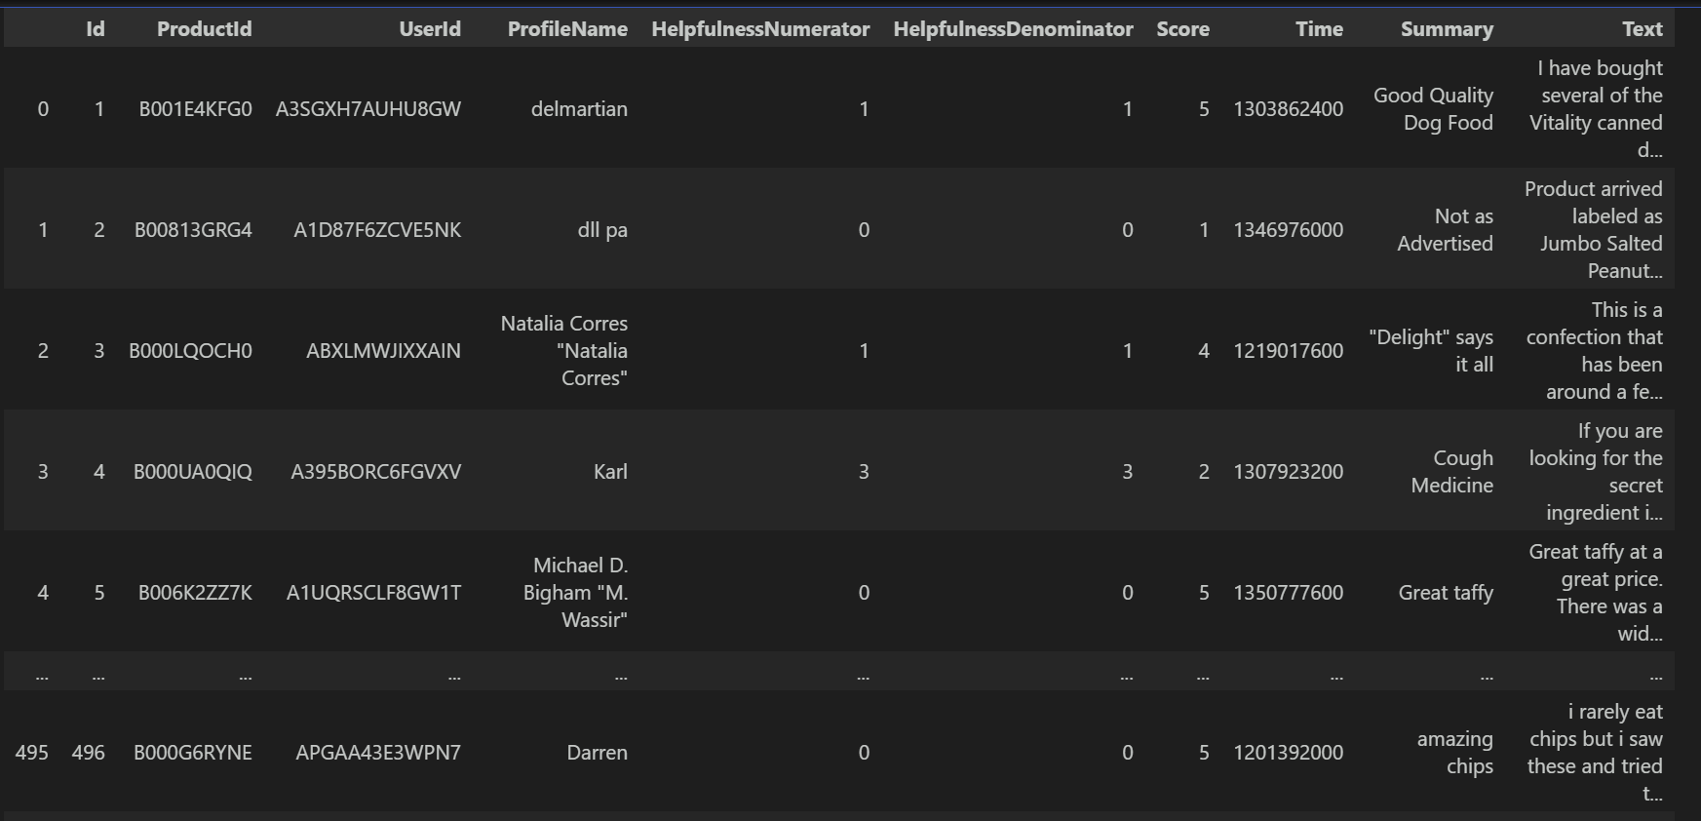
Dataset
To provide an illustrative snapshot of the loaded dataset, we present a sample of the data using a DataFrame display. This display showcases a few rows and columns, giving you a tangible glimpse of what the dataset looks like. It helps in visualizing the raw data before any analysis or processing is performed.

Slide 10
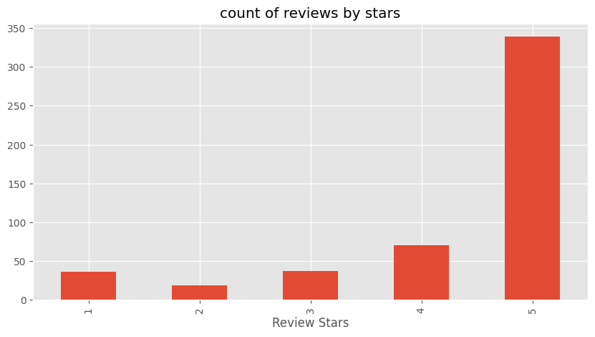
Exploratory Data Analysis (EDA)
In this section, we move beyond data loading and transition into exploratory data analysis (EDA). We begin by visualizing the distribution of reviews across different star ratings.

Slide 11
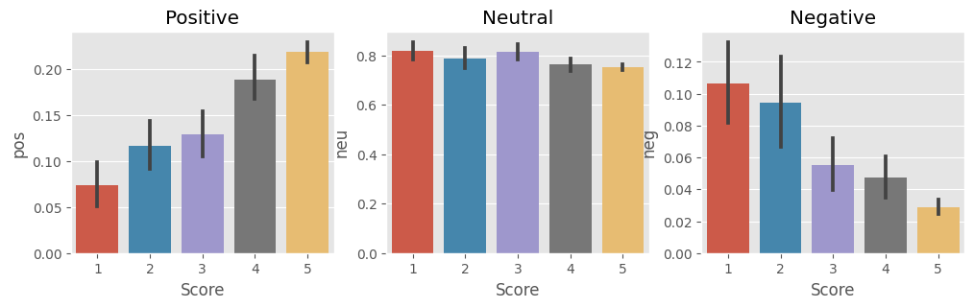
Exploratory Data Analysis (EDA)
The bar plot provides a direct link between review scores and sentiment. It is worth noting that higher star ratings often correspond to more positive sentiments. This correlation is a fundamental insight, and it serves as the basis for our sentiment analysis.

Slide 12
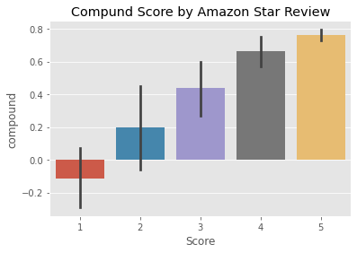
Sentiment Analysis with VADER
VADER, or Valence Aware Dictionary and sentiment Reasoner, is a rule-based sentiment analysis tool employed in our analysis process. This tool plays a pivotal role in assessing the sentiment of the customer reviews.
VADER relies on a predefined lexicon of words and their associated sentiment scores to determine the sentiment of text data. It operates based on a set of rules and patterns, making it a valuable tool for quick and rule-driven sentiment analysis.
To provide a practical illustration, we showcase how VADER analyzes the sentiment in a sample text from the dataset. This example text is processed by VADER, which assigns sentiment scores for various aspects, including:

Slide 13
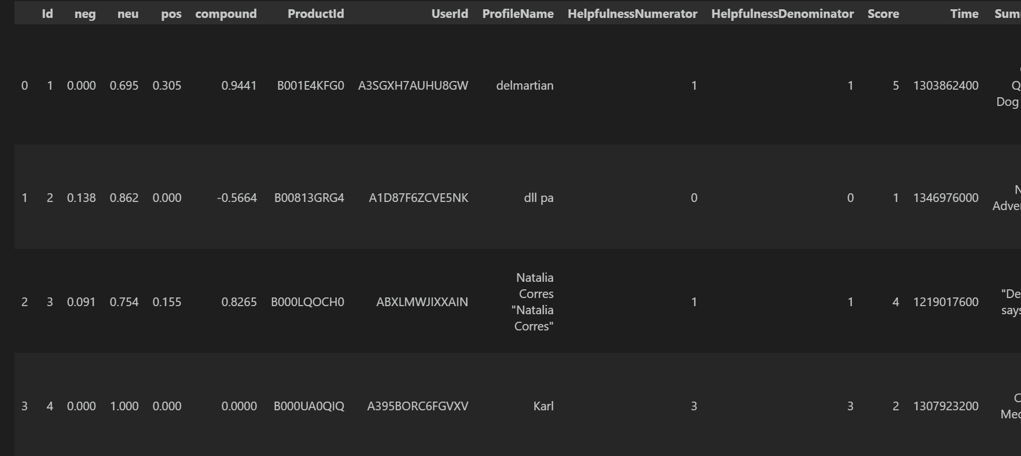
Positivity: VADER assesses how positive the text is and assigns a positivity score.
Neutrality: It also checks for neutrality in the text and assigns a neutrality score.
Negativity: Lastly, VADER evaluates the negativity of the text and assigns a negativity score.

Slide 14
Sentiment Analysis with RoBERTa
RoBERTa, short for "A Robustly Optimized BERT Pretraining Approach," is introduced as a neural network-based model that takes a deep learning approach to sentiment analysis. It is a powerful tool in our analysis process, offering advanced capabilities.
RoBERTa is well-suited for sentiment analysis and is particularly effective in understanding the nuanced context and semantics of text data. It leverages pre-trained neural networks to decode sentiment from textual information.
Similar to vader it assigns a score for the text with how much It is positive, negative , neutral
E.G. :- This oatmeal is not good. Its mushy, soft, I don't like it. Quaker Oats is the way to go.
Out[20]:
{'neg': 0.22, 'neu': 0.78, 'pos': 0.0, 'compound': -0.5448}

Slide 15
Combining VADER and RoBERTa
To combine the results from both VADER and RoBERTa, the code creates a Data Frame named results_df
where it stores the sentiment scores and other relevant information for each text in the dataset. This Data Frame contains columns for VADER and RoBERTa sentiment scores, among others.
The code also includes a visualization step where it uses seaborn to create a pair plot that allows you to compare the sentiment scores from both VADER and RoBERTa. This plot helps in visualizing the relationships between the two sentiment analysis methods and how they relate to the review scores.

Slide 16
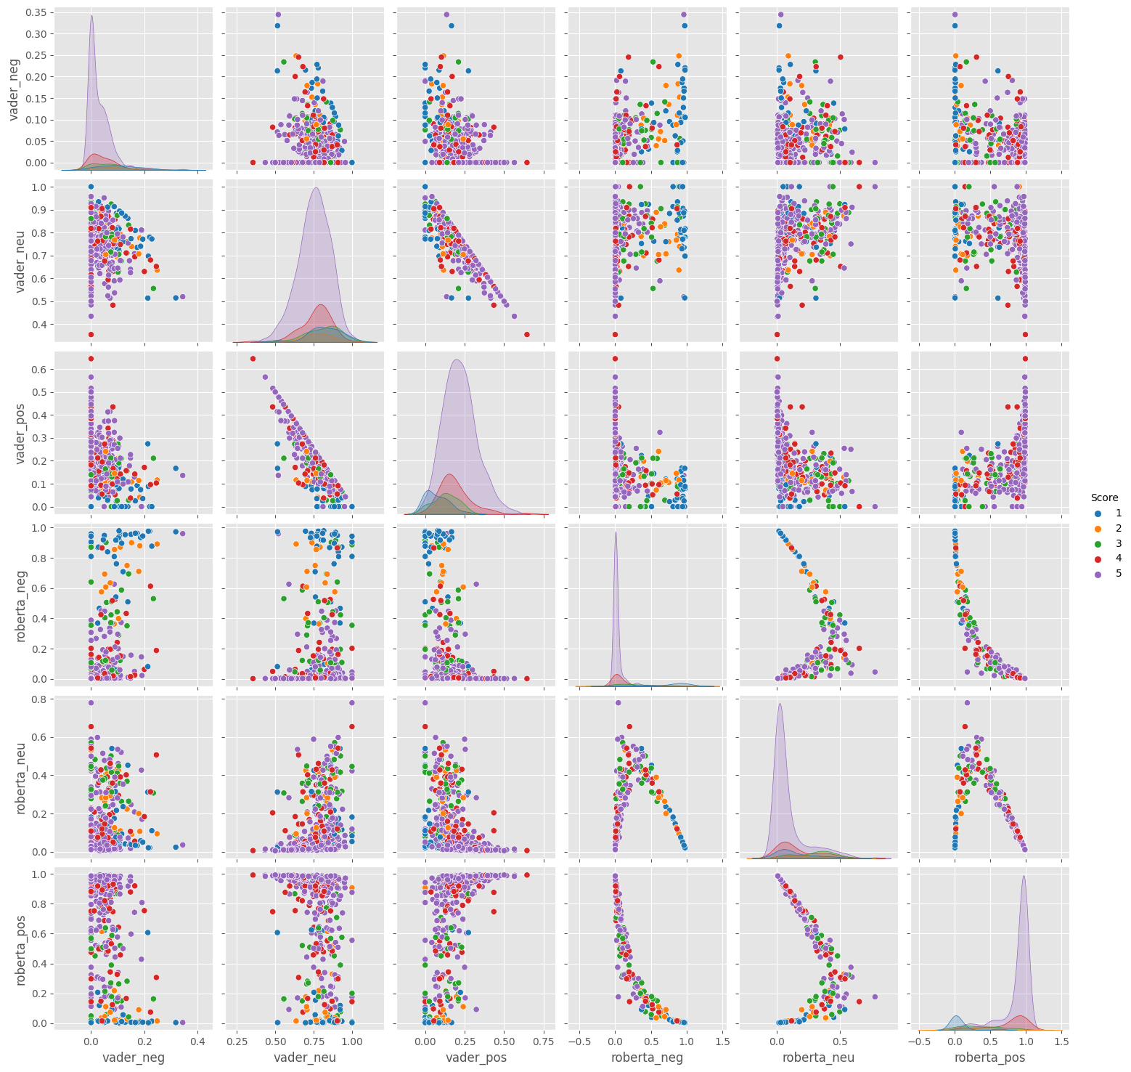
Visualization of Results

Slide 17
The Transformers Pipeline
A transformer pipeline model is a high-level interface provided by the Hugging Face Transformers library to perform specific NLP tasks using pre-trained transformer models.
These pipelines are designed to simplify the process of applying transformer models to various NLP tasks. They abstract away the complexities of model loading, tokenization, and inference.
Transformer pipeline model can also be used for sentiment analysis using text a simple application is provided inside the code as follows :-

Slide 18
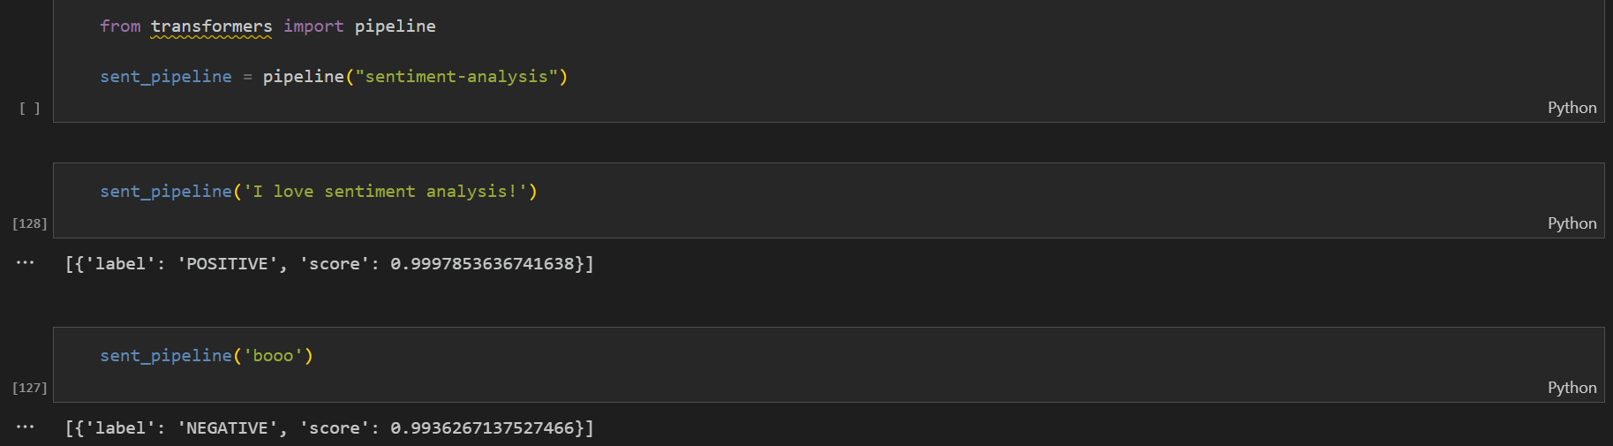

Slide 19

Thank YOU!

